Slide 1

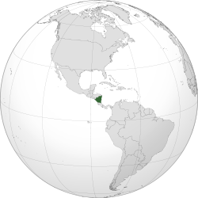


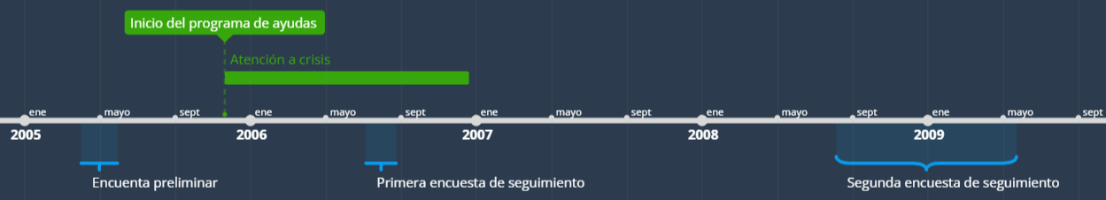









PROGRAMA ATENCIÓN A CRISIS
trials in the United States show that children who benefited from intensive preschool interventions have higher school attainment, better test scores, lower rates of criminality, and earn higher wages in adulthood (Currie 2001; Schweinhart 2005) This paper analyzes the impact of a cash transfer program on development in early childhood. The program, known as Atención a Crisis , made sizeable payments to poor households in rural areas in Nicaragua. The Atención a Crisis pilot program was implemented between November 2005 and December 2006 by the Ministry of the Family in six municipalities in rural Nicaragua.
irst, among all communities in the six municipalities, 56 intervention and 50 control communities were randomly selected through a lottery. Second, baseline data were collected in both treatment and control communities. Baseline data for the evaluation were collected in April-May 2005. A first followup survey was collected in July-August 2006, nine months after the households had started receiving payments. The sample includes the 3,002 eligible households in the treatment group, and a random sample of 1,019 eligible households in the communities that were assigned to the control group. A second follow-up survey, covering the same households as those included in the first follow-up, was collected between August 2008 and May 2009 (henceforth referred to as 2008).
TEMPORIZACIÓN
TRATAMIENTOS: AYUDAS A LA UNIDAD FAMILIAR
+
Formación/divulgación sobre la importancia de hábitos saludables, educación, etc.
T1
Pago por un valor de ~15% del gasto medio anual per capita
Entregado al cuidador principal de los hijos (en su mayoría, a la madre)
Con una frecuencia bimestral
T2
T1
+
Curso de formación vocacional/profesional
T3
T1
+
Beca para el desarrollo de una actividad económica no agrícola

Slide 2





and caregivers' mental health.
Finally, caregivers' observed parenting behaviour was registered through a shortened version of the HOME score
comprehensive information on household socioeconomic status, including detailed expenditure modules
child health and nutrition, including child height and weight, and one measure of child cognitive development, the TVIP
Social-personal, language, fine motor, and gross motor skills for all children using the four sub-scales of the Denver Developmental Screening Test
For children age 36 months and older, we applied five additional tests. The first of these is the TVIP. We also use a short-term memory test from the McCarthy test battery
test of leg motor development from the McCarthy test battery
The final test we use is the Behavior Problem Index (BPI),
The two follow-up surveys also include information on stimulation, birthweight, preventive health care,

